Slide 1


Exploring Frequency Adversarial Attacks for Face Forgery Detection
Shuai Jia¹ Chao Ma^{1*} Taiping Yao² Bangjie Yin² Shouhong Ding² Xiaokang Yang¹
¹MoE Key Lab of Artificial Intelligence, AI Institute, Shanghai Jiao Tong University
²Youtu Lab, Tencent
CVPR 2022
Notes:
人脸伪造检测中的频率对抗攻击研究

Slide 2
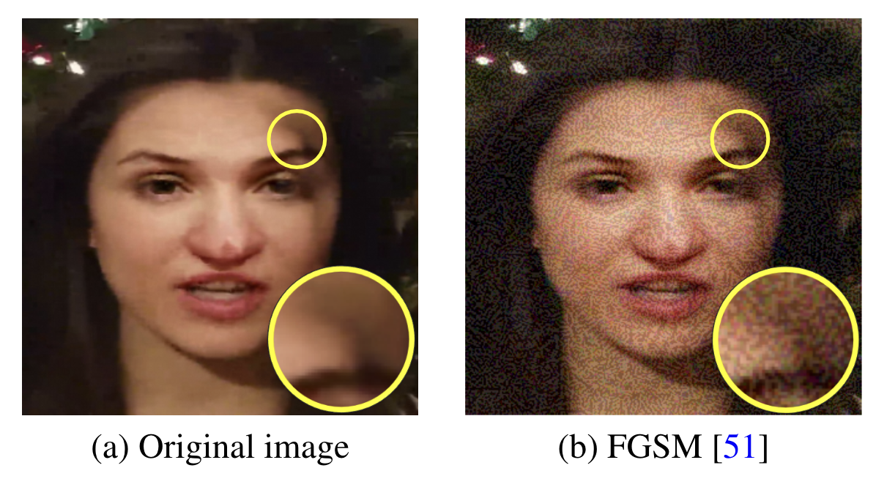
Motivation
Various facial manipulation techniques have drawn serious public concerns in morality, security, and privacy.
Existing face forgery classifiers are vulnerable to adversarial examples with injected imperceptible perturbations on the pixels.
Many face forgery detectors always utilize the frequency diversity between real and fake faces as a crucial clue.

Slide 3
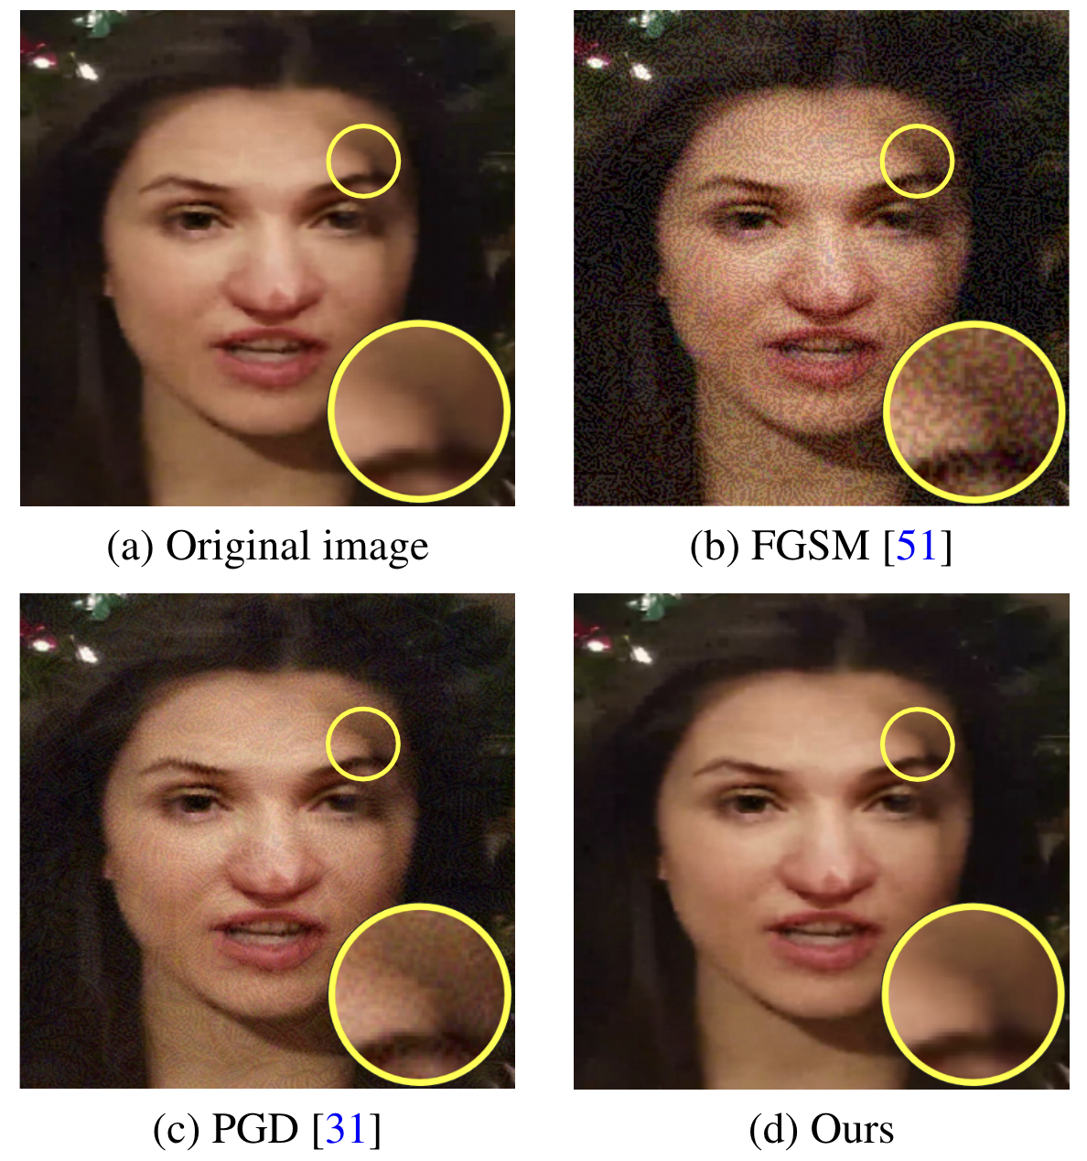
Motivation
In this paper, instead of injecting adversarial perturbations into the spatial domain, we propose a frequency adversarial attack method against face forgery detectors.

Slide 4
Contributions
For the task of face forgery detection, we propose anovel adversarial attack method to generate perturbations in the frequency domain. Compared with the previous attacks, our method generates more imperceptible perturbations for human observers.
To further boost the transferability of the attack, we propose a hybrid adversarial attack based on the strategy of meta-learning to simultaneously perform attacks on the spatial and frequency domain.
We perform the proposed method both on the spatial-based face forgery detectors and the state-of-the-art frequency-based detectors. Extensive experiments on benchmarks demonstrate the effectiveness of our attack under both white-box and black-box settings.

Slide 5
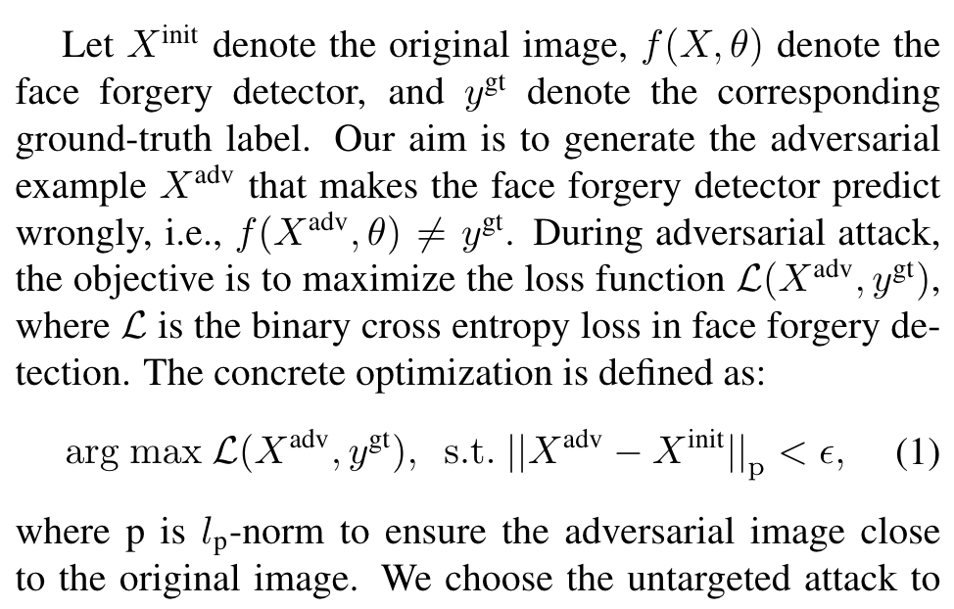
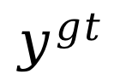
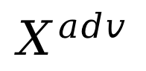
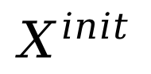
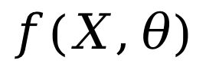
Methodology
$$X^{init}$$
$$f(X,θ)$$
×
$$y^{gt}$$
$$X^{adv}$$

Slide 6
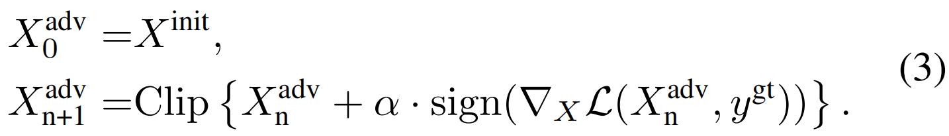
Spatial Adversarial Attack
Fast Gradient Sign Method (FGSM). FGSM is a single-step attack method that calculates the perturbations based on the gradient of the adversarial loss. The optimization is defined as:
Projected Gradient Descent (PGD). PGD is a multi-step variant of FGSM. Meanwhile, it adopts a random initialization of perturbations at the first step. The update procedure is defined as:

Slide 7
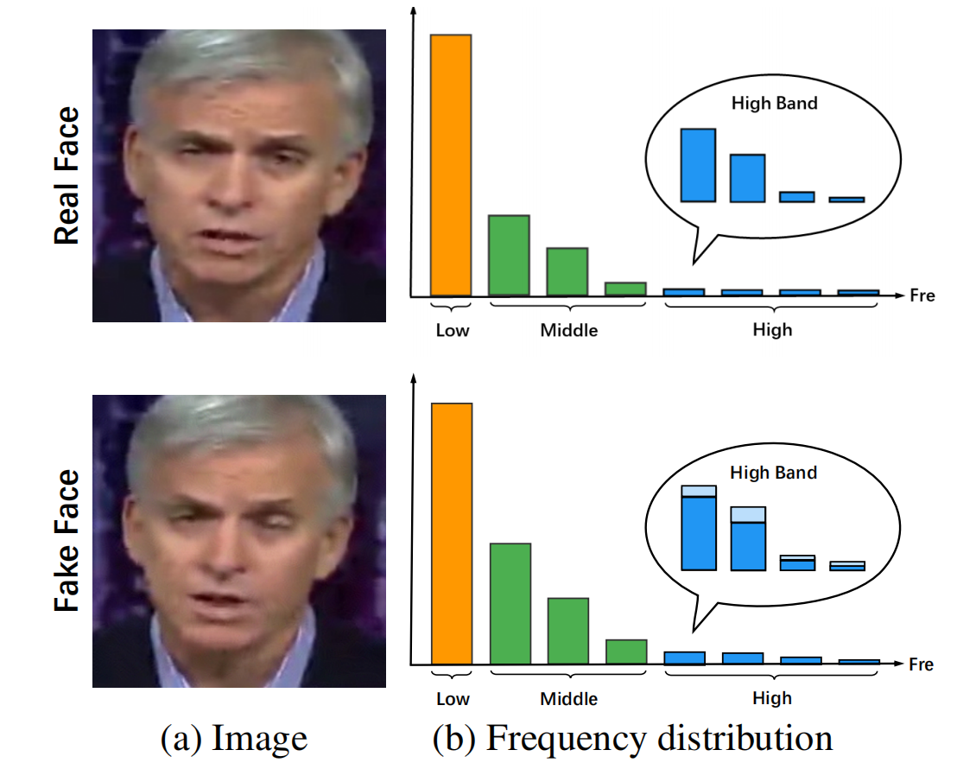
Frequency Adversarial Attack

Slide 8
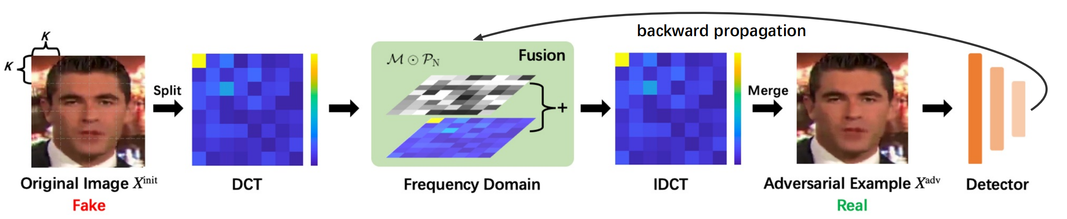
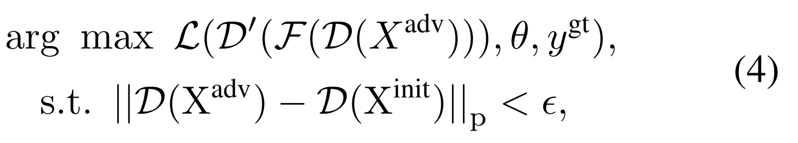
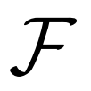
Frequency Adversarial Attack
We summarize the optimization procedure as follows:
represents the fusion module to modify the energy in the frequency domain.

Slide 9
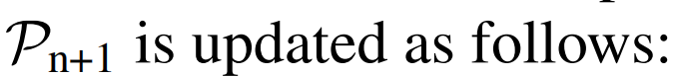
Frequency Adversarial Attack
The complete fusion module is defined as:

Slide 10
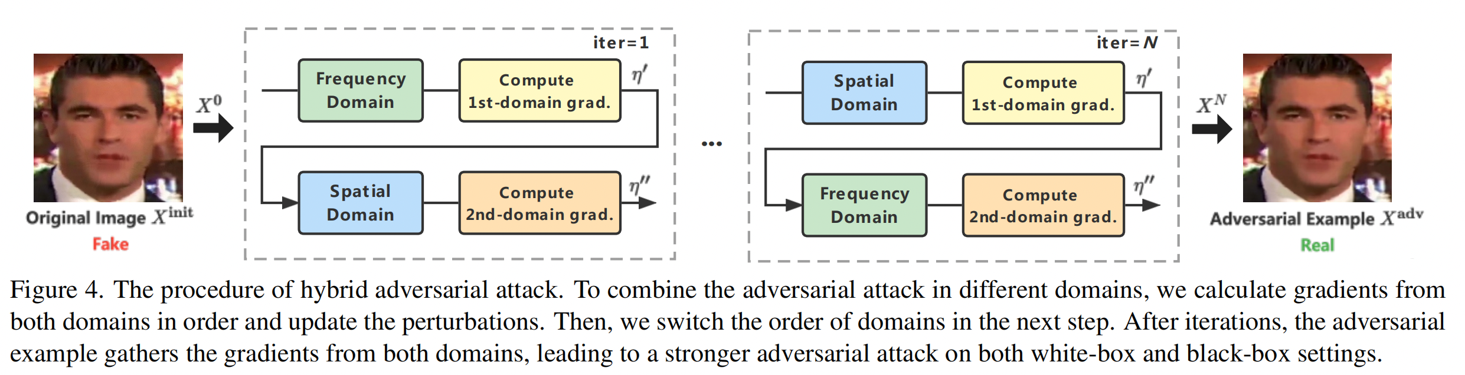
Hybrid Adversarial Attack

Slide 11
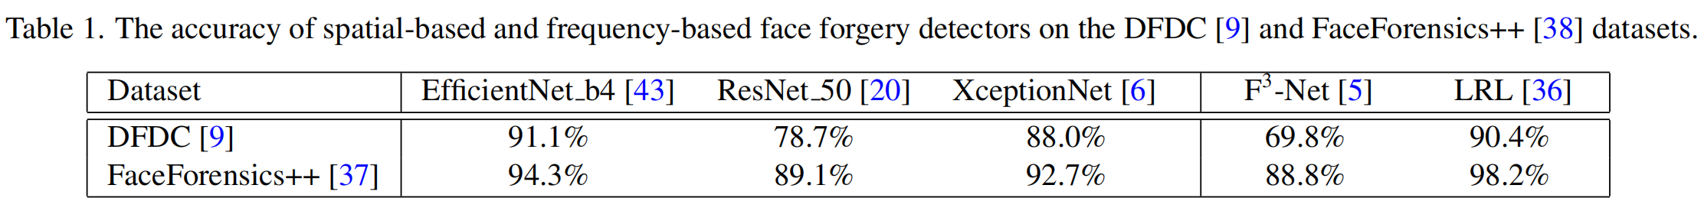
Experiments
Datasets: DFDC and FaceForensics++
Metric: Attack Success Rate
Forgery Models: Spatial-based: EfficientNet b4, ResNet 50, and XceptionNet;
Frequency-based: F3-Net and LRL.

Slide 12
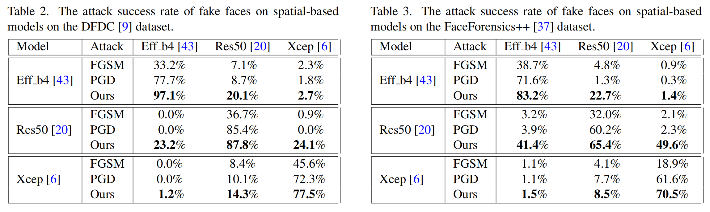
Attack on Spatial-based Models

Slide 13
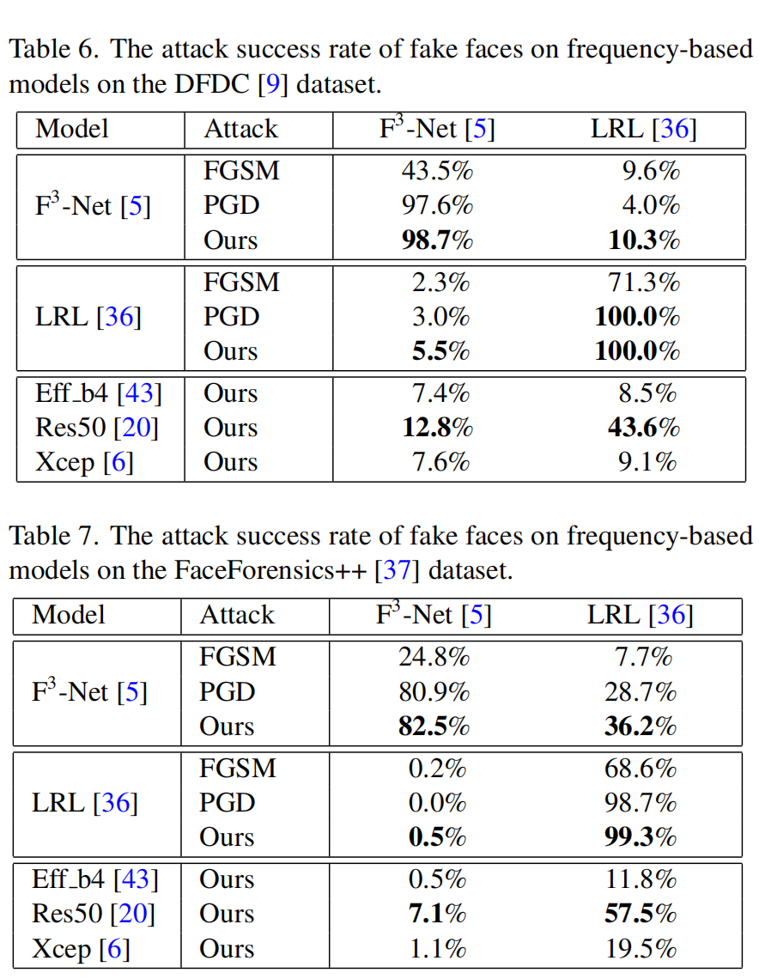
Attack on Frequency-based Models

Slide 14
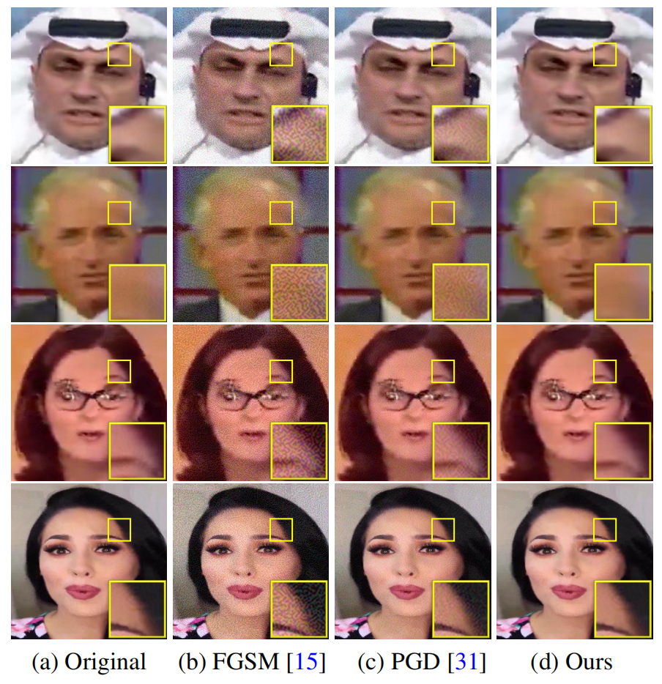
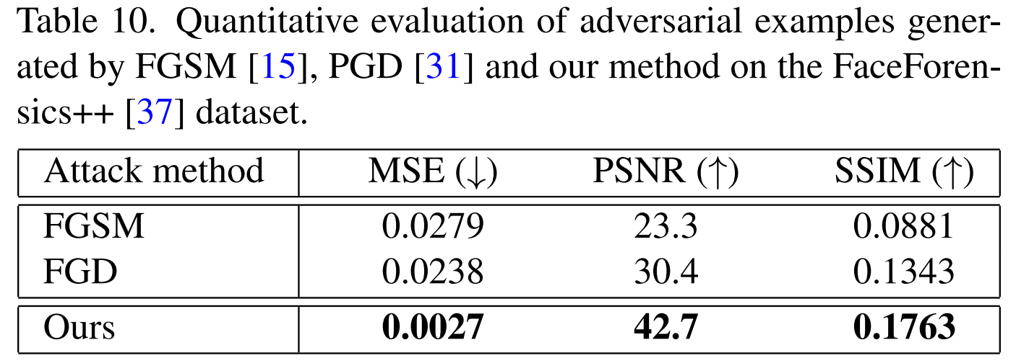
Image Quality Assessment

Slide 15

Q&A
Thank you!

